Slide 1

NATURAL LANGUAGE PROCESSING IN SOCIAL MEDIA
SUBMITTED BY :-
Name : Km Neha Andola
University Roll No. : 2018888
UNDER THE MENTORSHIP OF –
MR. KIREET JOSHI

Slide 2
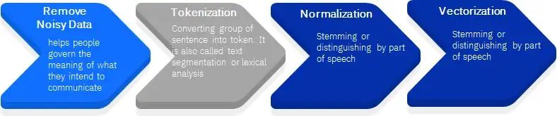
INTRODUCTION
NATURAL LANGUAGE PROCESSING (NLP)
Natural Language Processing (NLP) refers to the branch of computer science, more specifically, the branch of Artificial Intelligence or AI concerned with giving computers the capability to understand text and spoken words in important the same way mortal beings can.
NLP has two main phases, Data pre-processing and Algorithm Development.
Data pre- processing involves preparing and" drawing" text data for machines to be suitable to assay it. It puts data in workable form and highlights features in the text that an algorithm can work with.
Once the data has been pre- processed, an algorithm is developed to exercise it.

Slide 3
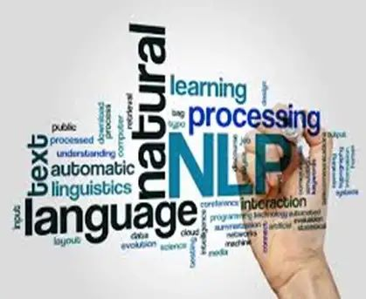
NLP IN SOCIAL MEDIA
Natural language processing (NLP) has witnessed an increasing adoption in the world of social media. The reason behind this is because of the ever- growing number of social media channels, where people are posting, blogging, and editorializing on various motifs. With its use, you can easily prize information and also use that information to needleworker your marketing campaigns specifically to them. It has witnessed an adding handover in the world of social media. Social media is a boon for the businesses as it connects them directly with the guests. NLP can be used to break a wide range of problems, from helping people search for information to encapsulating text to detecting sentiment (Sentiment Analysis).

Slide 4
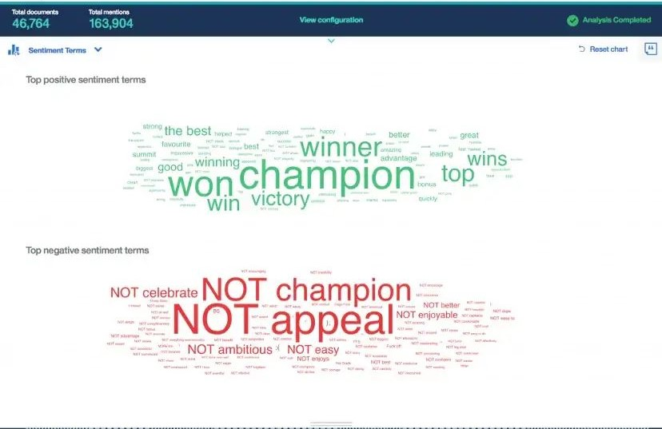
SENTIMENT ANALYSIS (SA)
NLP allows various businesses to interact with the guests and avail the feedbacks and suggestions on their products and services. Sentiment analysis, also known as opinion mining, is the use of natural language processing (NLP), text analysis, and computational linguistics to identify and prize private information from source. Sentiment analysis is widely applied to voice of the customer materials such as reviews and survey responses, online and social media. It is one of the techniques of semantic analysis.
PROBLEM STATEMENT
The main aim of this design is to assay and determine the text (ex- customer reviews) in positive and negative terms. The problem is faced in getting to understand the various modules and the library functions of python and when to use those libraries.

Slide 5
METHODOLOGY
LIBRARY USED : NATURAL LANGUAGE TOOLKIT (NLTK)
NLTK, or Natural Language Toolkit, is a Python package which contains packages to make machines understand mortal language and reply to it with an applicable response that you can use for NLP.
NLTK Library contains libraries and programs for statistical language processing.
It's designed for fast trial and allows for easy structure of modules.

Slide 6
APPROACH
The methodology used is to train a language model using a text and train and assay the true sentiment behind the given input expression.
This model is trained using the NLTK library in Python.
The model is created using the Sentiment Intensity Analyser from the NLTK library's models' module. It helps us to assay the emotion of the textbook, either positive or negative or neutral.
STEPS
The first step is to read the input given by user and initialize Sentiment Analyser.
Input given by user is then analysed using two-processes:
(1) Word Sense disambiguation - It's an automatic process of relating the environment of any word, in which it's used in the judgment. In natural language,

Slide 7
one word can have numerous meanings.
(2) Relationship birth – In a judgment, there are a many realities that are co-related to each other. Relationship birth is the process of rooting the semantic relationship between these realities.
After processing the data, the score of the analysis is stored in a variable which is published using print statement.

Slide 8
RESULT AND DISCUSSIONS
The model is created using the programming language which is Python. It's a popular, high level programming language known for its clear syntax, dynamic semantics, and support for object- acquainted programming. It’s erected in data structures and support for dynamic typing and binding make it a seductive choice for rapid-fire operation development and connecting being factors. This design makes use of NLTK (Natural Language Toolkit) Library of python which is substantially used in any operation of NLP (Natural Language Processing) to prop in its functionality. Sentiment Intensity Analyser is used to break the text commemoratives and process it using two ways. They're Word Sense Disambiguation and Relationship birth.

Slide 9
Word Sense Disambiguation is used to remove ambiguation that can arise from a word having two or further meaning to it. For partner- “Light” can have two meanings – not veritably heavy and the other as not veritably dark.
Relationship birth is also used to prize or find relation between two realities.
The Sentiment Analysis is initialized. The score (tells us about negative, positive and neutral points and status) is also calculated by passing the input text from user in polarity_scores which is called with the help of sentiment analysis analyser.

Slide 10
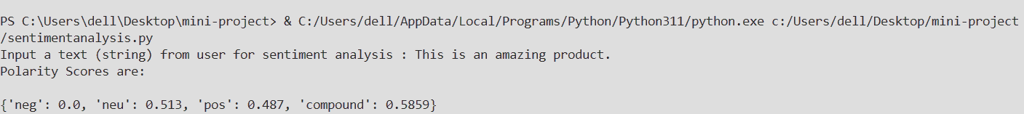
A simple demonstration of the design is shown in the following runner. Here we can see that how the basic implementation of the design is done. The output that we got after implementing the code:

Slide 11
CONCLUSION
Sentiment Analysis (SA) is a fashion of Natural Language Processing(NLP) which uses the Natural Language Toolkit( NLTK) Library to assay the sentiment behind a given textbook or judgment . This technology has a wide range of implicit uses. Sentiment Analysis is now by and large considered to be critical in terms of socio-profitable viewpoint. Understanding SA and examining the styles that can help achieve delicacy in a wide variety of input formats is critical for businesses, institutions a, institutions and individuals to survive and succeed.

Slide 12
FUTURE WORK
The ensuing areas of enhancement will be concentrated on in future in order to enhance the capabilities of the coming word vaticination model
• Increase in delicacy through the disquisition of new ways and styles.
• Expansion of the training dataset for the model to learn further patterns and ameliorate performance.
• Testing on different types of textbooks.

Slide 13
THANK YOU

